Slide 1
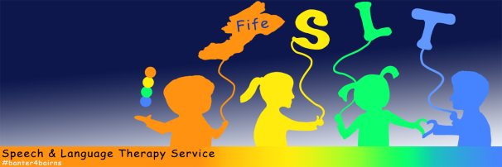




Do you live in Fife and have concerns about your child's speech,
language or communication skills? We have experienced therapists
available to take your calls if you have any questions
ADVICE LINE!!
December opening times
Tuesdays
2pm – 4pm
Thursdays
10am – 12noon
(closed 18th Dec – 4th Jan)
01592 226 699
Notes:
Please remember we have a new advice line telephone number 01592 226 699. #banter4bairns

